Slide 1
Hands-on Microservices
19 November 2024
Nama: Ariski Myardi
NIM: 1103220019

Slide 2
Hands-on Microservices
Membangun Layanan Sederhana dengan Node.js atau Python
Membuat Docker Image untuk Layanan
Mendeploy Layanan ke Kubernetes Cluster
Mengelola Layanan dengan Kubernetes

Slide 3
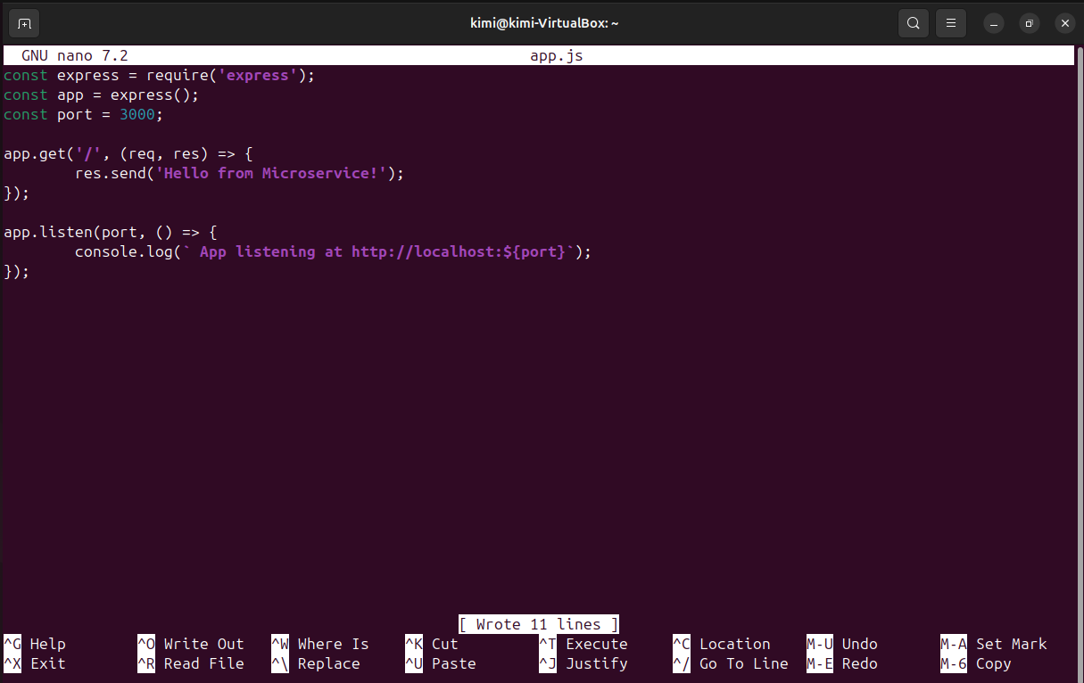
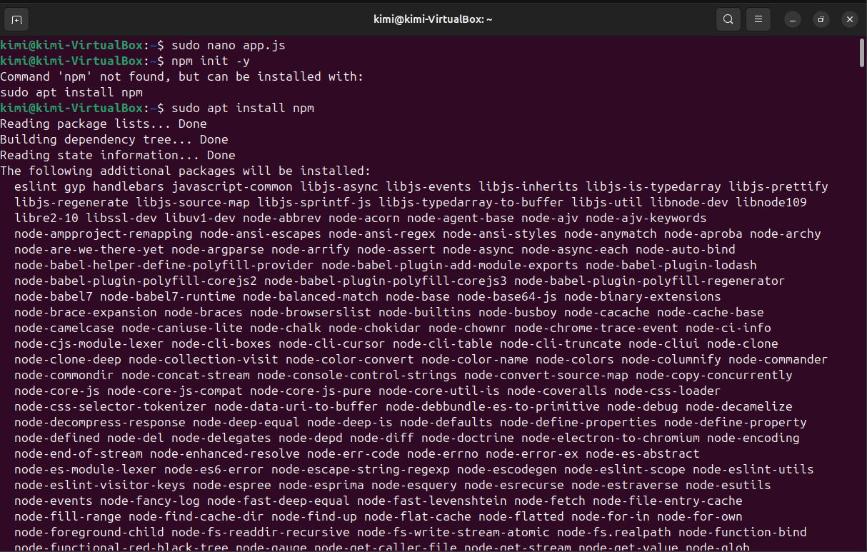
Membangun Layanan app.js
const express = require('express'); const app = express(); const port = 3000; app.get('/', (req, res) => { res.send('Hello from Microservice!'); }); app.listen(port, () => { console.log(`App listening at http://localhost:${port}`); });

Slide 4
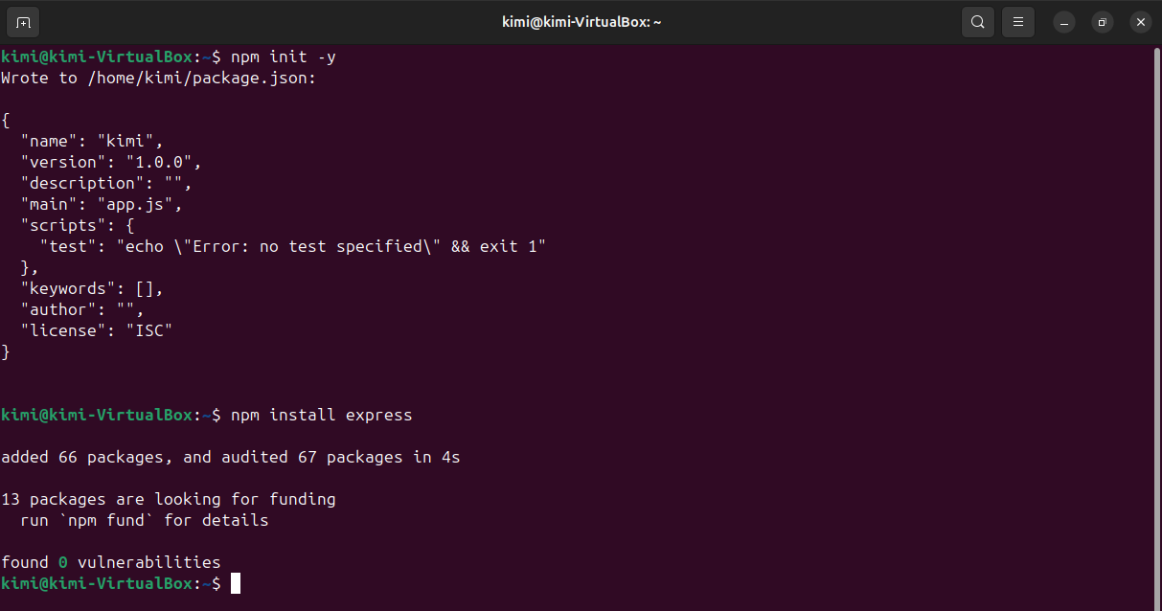
Inisialisasi Project
npm init -y
npm install express

Slide 5
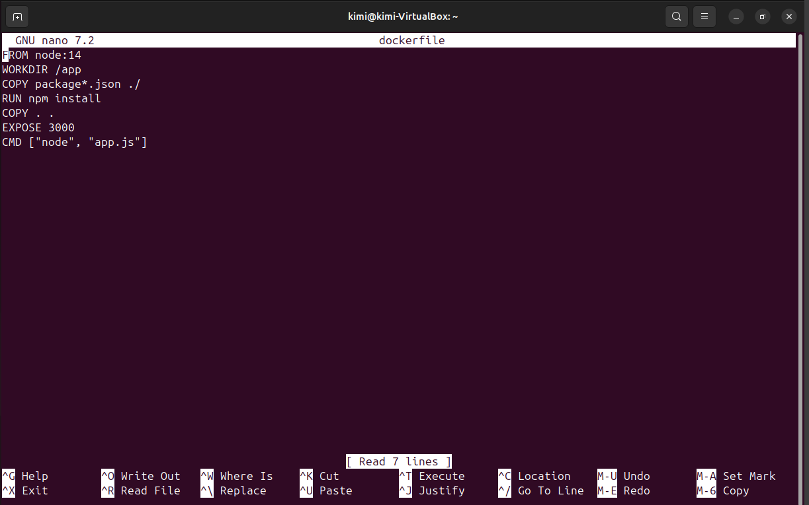
Buat Dockerfile
FROM node:14 WORKDIR /app COPY package*.json ./ RUN npm install COPY . . EXPOSE 3000 CMD ["node", "app.js"]

Slide 6
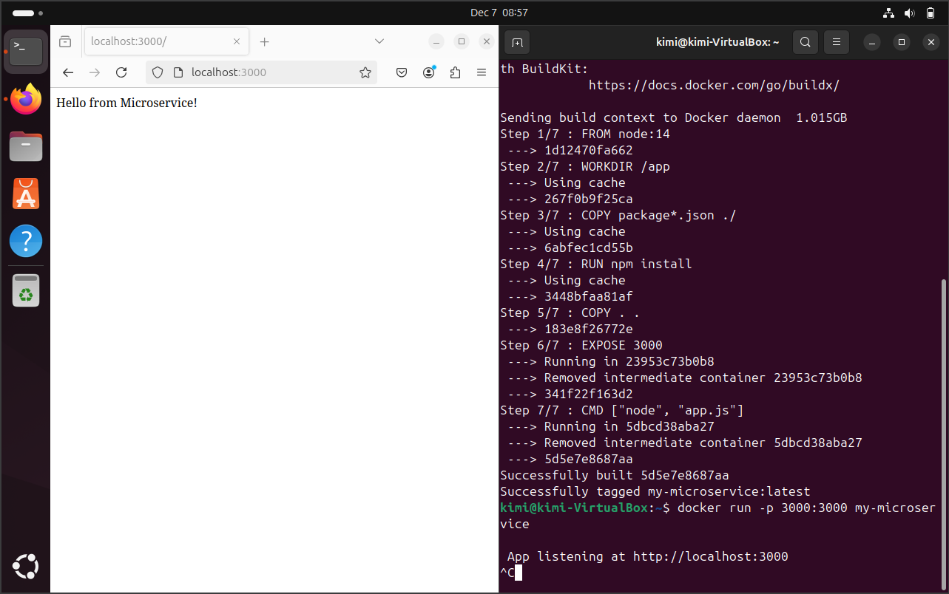
Membangun dan Menjalankan Docker
Bangun Image Docker:
  docker build -t my-microservice . (jangan lupa ada titik di belakang)
Menjalankan Container
  docker run -p 3000:3000 my-microservice
Verifikasi
  Akses http://localhost:3000 di browser.

Slide 7
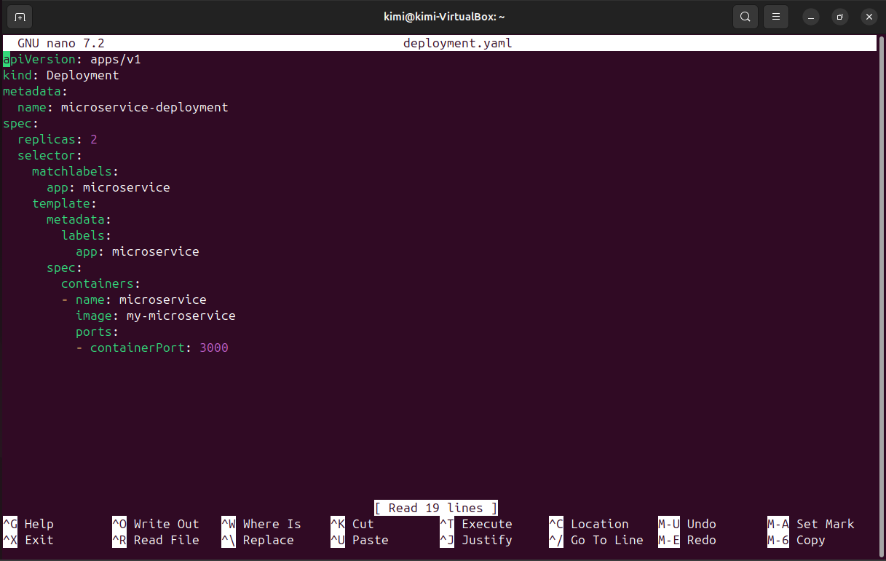
Pembuatan Manifest Kubernetes deployment.yaml
apiVersion: apps/v1 kind: Deployment metadata: name: microservice-deployment spec: replicas: 2 selector: matchLabels: app: microservice template: metadata: labels: app: microservice spec: containers: - name: microservice image: my-microservice ports: - containerPort: 3000

Slide 8
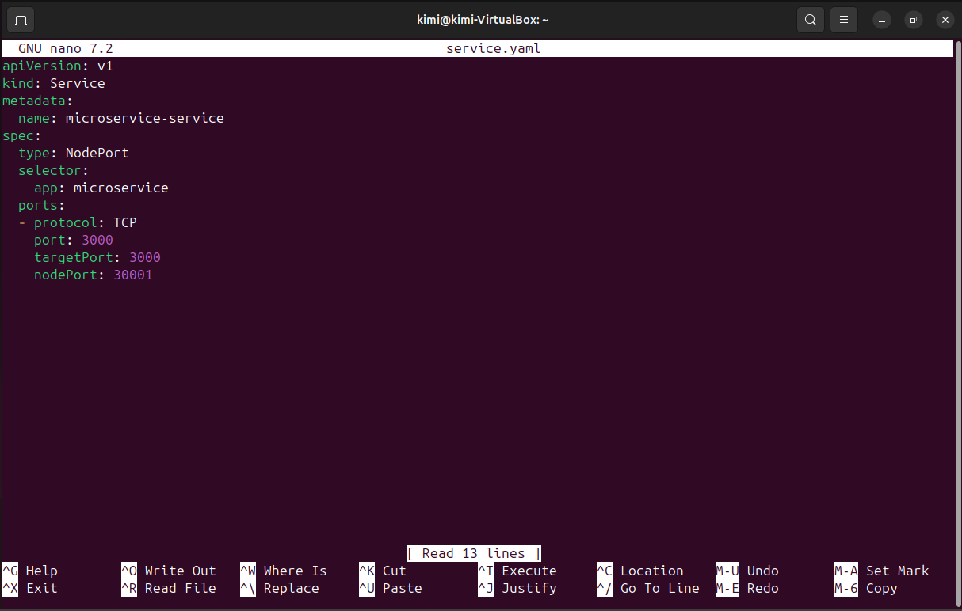
Pembuatan Service Manifest service.yaml
apiVersion: v1 kind: Service metadata: name: microservice-service spec: type: NodePort selector: app: microservice ports: - protocol: TCP port: 3000 targetPort: 3000 nodePort: 30001

Slide 9
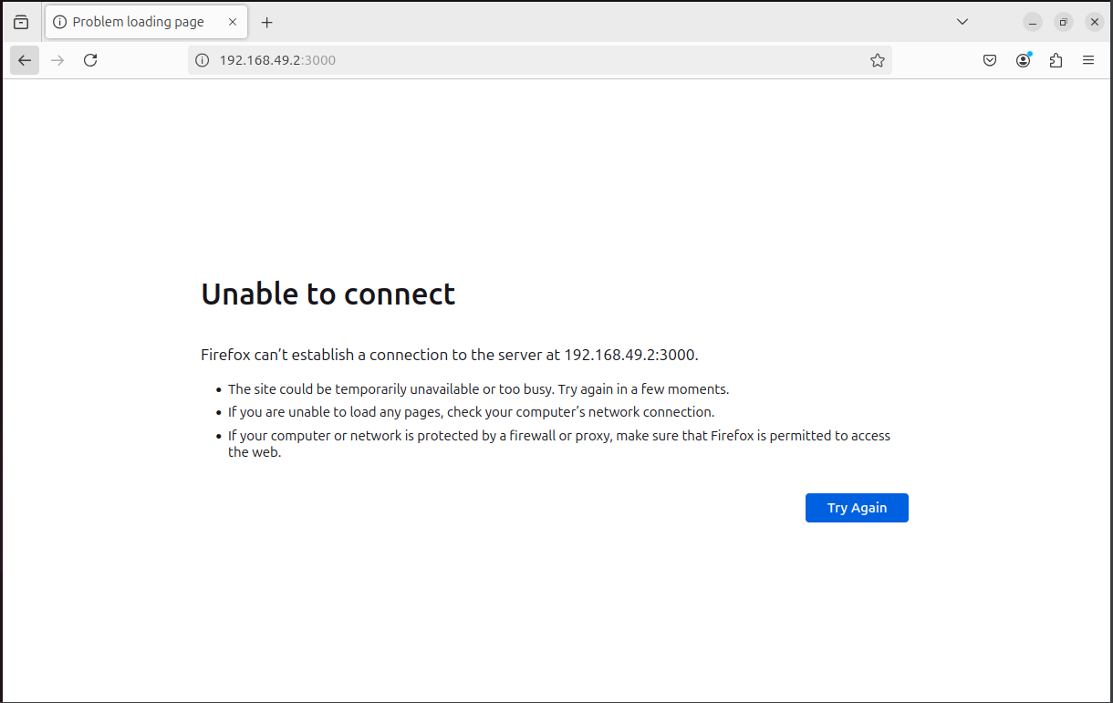
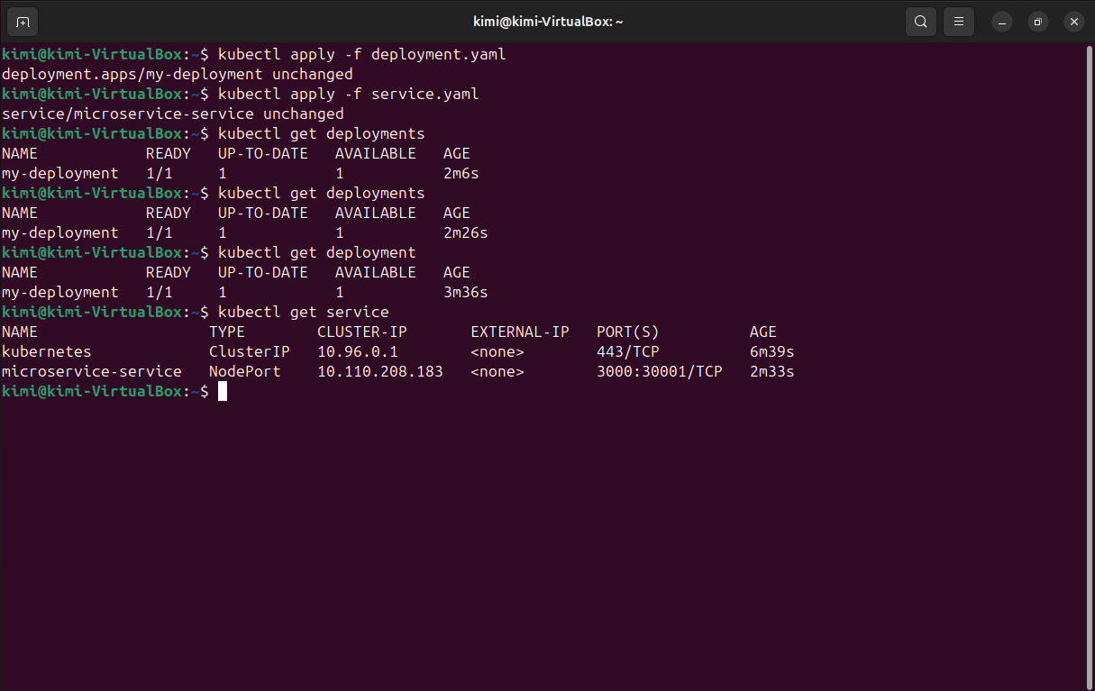
Deployment
Deploy ke Kubernetes
  kubectl apply -f deployment.yaml
  kubectl apply -f service.yaml
Verifikasi deployment
  kubectl get deployments
  kubectl get services
Akses
  http://<minikube_ip>:30001
  Alamat IP: jalankan command berikut
    minikube ip

Slide 10
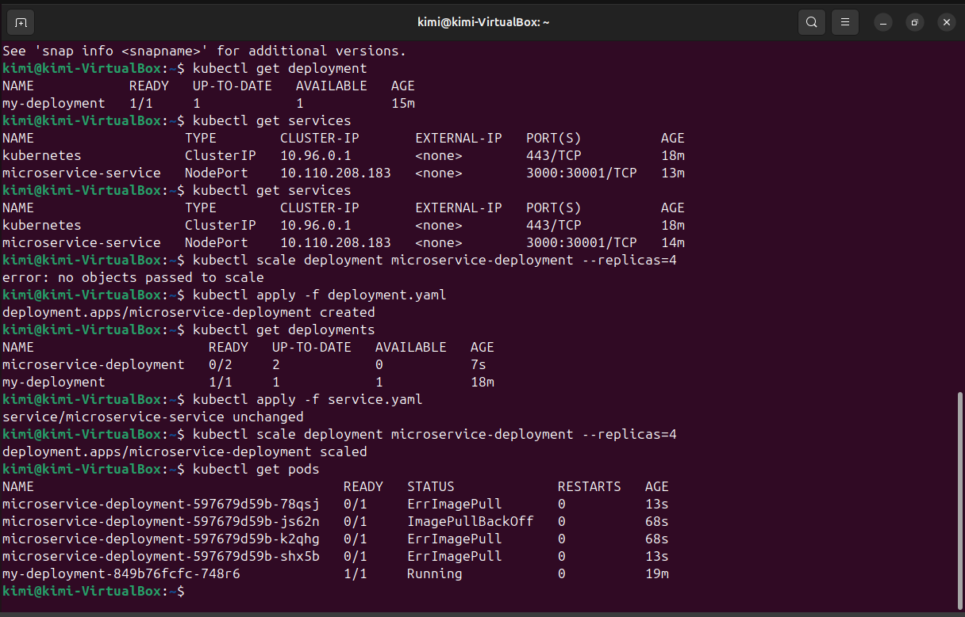
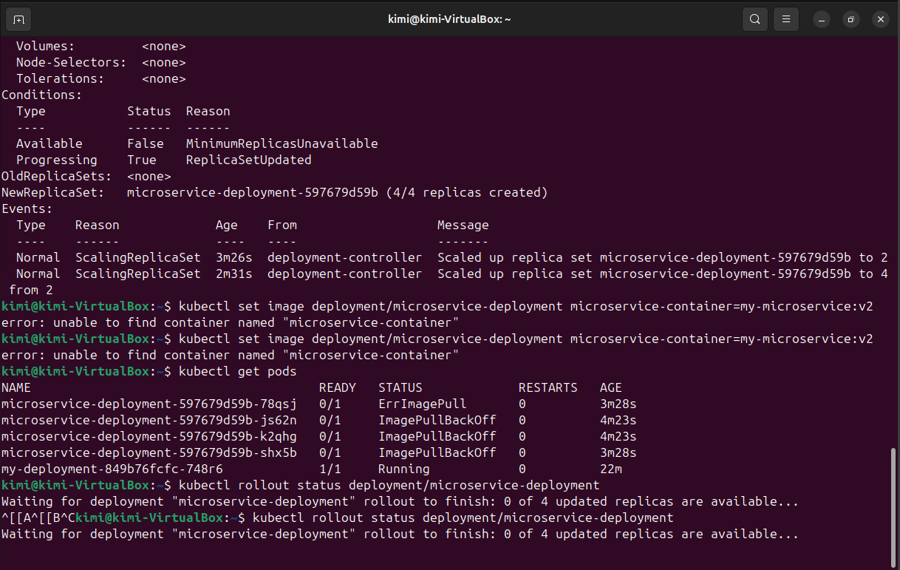
Pengelolaan Layanan Kubernetes
Skalabilitas
  Mengubah jumlah replika
    kubectl scale deployment microservice-deployment --replicas=4
  Verifikasi jumlah pods
    kubectl get pods
Update
  Update image
    kubectl set image deployment/microservice-deployment microservice=my-microservice:v2
  Cek status rollout
    kubectl rollout status deployment/microservice-deployment

